Slide 1
Culturally Sensitive Interventions for Refugee Women Experiencing Sexual and Gender-Based Violence
Helen Akeri, MSW, ’20; Aurora Chen, MPH/MBA ’21;
Yiting Liang, MPH, ’19; Netletha Sumo, MSW, ‘20, Brown School
The current project examined interventions and identified gaps for gender based violence against refugee women in Germany and the United States.
Background
Methods
Case Studies in Germany
Discussion
Sexual and gender-based violence (SGBV) refers to any act that is perpetrated against a person’s will and is based on gender norms and unequal power relationships¹.
Refugee women are extremely vulnerable to sexual assault and exploitation, including rape.
Sexual and gender-based violence is identified as both a reason why refugees and migrants are leaving countries of origin and first asylum, and a reality for women and girls along the refugee and migration route².
Merely in 2015, 1.1 million asylum-seekers arrived in Germany, and as a result, Germany experienced immense strain to support the welfare and social support afforded to the large number of arrivals, particularly in preventing SGBV among refugee groups³.
Existing literature was reviewed for available secondary data regarding the topic;
The case of the organizations in Berlin were studied during the Berlin course; thorough talks with the staffs from the organizations and information provided by the studied organizations were referred to.
Case 3: reWoven
  An organization focused on analyzing the interactions between refugee women and German women who volunteer to provide psychosocial support for the refugee women.
  Specifically, the research conducted by this organization addresses how experiences of gender based violence affect both refugees and the volunteers. The hope of the research is to develop practical interventions for working with refugees that have experienced SGBV.
The German experience has significant implications for the United States in dealing with migration population with SGBV issues at the southern border.
Limitations
  SGBV are particularly underreported, leading to the lack of specific numbers on victim case numbers.
  During the Berlin course, we didn’t have a chance to interview female refugees directly in person.
  A lot of the secondary data focused on the “refugee crisis” time which was in mainly in 2015, so there was a lack of more recent studies and data.
Case Studies in Germany
Case 1: S.I.G.N.A.L. e.V.
  S.I.G.N.A.L. partners with stakeholders in the healthcare system to provide support to survivors of domestic violence including refugee women. The goal is to mitigate the short, medium and long term health consequences associated with sexual and domestic violence.
  Their focus is on healthcare based interventions to address sexual and domestic violence which include linking women to resources and training healthcare professionals in best practices for working with survivors of sexual and domestic violence.
Case 2: Les Migras
  An organization that is engaged in anti-discrimination and anti-violence work by offering counseling and a space for self-empowerment for individuals who have experienced discrimination and or/SGBV
  They also advocate for the rights of LGBTQI+ individuals and acknowledge how religion, social class, race, and culture influences the experiences of the individuals they serve.
Recommendations
Regulating at policy level
Separate housing and guarding for population at risk
Standard workflow training for customs officers
References
UNHCR. Sexual and Gender Based Violence. https://www.unhcr.org/en-us/sexual-and-gender-based-violence.html. Published 2001. Accessed June 21, 2019.
European Union Agency for Fundamental Rights. Thematic focus: Gender-based violence | European Union Agency for Fundamental Rights. https://fra.europa.eu/en/theme/asylum-migration-borders/overviews/focus-gender-based-violence. Published 2016. Accessed June 21, 2019.
Women’s Refugee Commission. Falling Through the Cracks: Refugee Women and Girls in Germany and Sweden.; 2016.
Research Aims
To identify existing interventions for gender-based violence for refugee women in the United States and Germany
To examine how culture affects what gender-based violence interventions are utilized for refugee women
To identify gaps in addressing gender-based violence among the refugee population and make recommendations on how these gaps can be filled
To contrast the type of SGBV interventions and to consider the use for reference when tackling with the similar issue in the U.S.
First-line immediate support
Post-trauma further care
Counselling and clinical care at community level
Notes
Empowering and prevention at Individual Level
Safety training
Sexual education
Job-searching training
Contact Presenter Name: presenter@wustl.edu
Note: The work presented here was done for the purposes of the course S81 SWIP 6100 01 Refugee Empowerment, Physical Activity and Urban Development In Berlin, Germany and is not my thesis or dissertation.

Slide 2
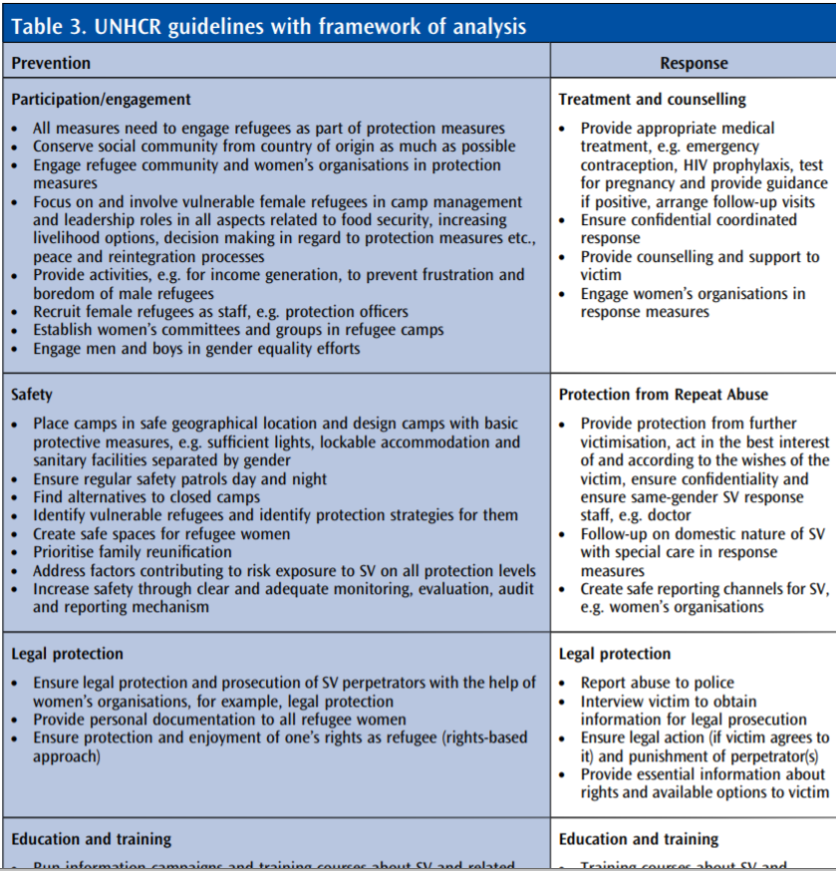

Slide 3
